Slide 1

MULTI-ARMED BANDITS
Optimal Decision-Making Under Uncertainty
Lance | Wilson | Zakaria | Tatum | Kenny
March 26, 2026
Notes:
WILSON — 0:00-1:00 • Welcome everyone, introduce the team • Today's topic: making optimal decisions when you don't know which option is best • Real-world stakes: Google A/B tests, clinical trials, investment strategy • Tease the interactive game — they'll be playing on their phones • Set energy: this is a workshop, not a lecture — participation matters

Slide 2



THE EXPLORATION-EXPLOITATION DILEMMA
You have multiple options. Each has an unknown success rate.
You have
limited attempts. What do you do?
EXPLOIT
EXPLORE
MIX STRATEGICALLY
Pick what's worked so far
Try something new
Balance both intelligently
Notes:
WILSON — 1:00-2:30 • Frame the core dilemma: exploit vs explore vs mix • Give everyday examples: picking restaurants, choosing jobs, dating • Business examples: which website design converts better? which ad to show? • Medical: which treatment saves more lives — do you keep testing or commit? • Key point: today we solve this for student networking, but these principles are universal • Ask audience: 'Who's ever stuck with a restaurant they know instead of trying somewhere new?' — that's exploitation • Pause on each card — let them absorb the three options

Slide 3

PULL OUT YOUR PHONES
[ INSERT QR CODE ]
bandit-game.vercel.app/play
Notes:
WILSON — 2:30-4:00 • 'Pull out your phones and scan this' • Read the URL out loud as backup for anyone who can't scan • Wait 60-90 seconds — don't rush this, let everyone get loaded in • Walk around and help anyone having trouble connecting • Confirm people are seeing their assigned persona on screen • 'Don't share your persona with anyone yet — that matters later'

Slide 4



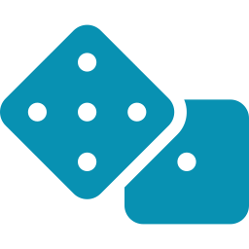

HOW THE GAME WORKS
You're a student building your professional network
4 types of connections available to explore
Each has a HIDDEN response rate you must discover
3 rounds, 4 attempts per round = 12 total tries
Goal: Maximize successful connections
Notes:
LANCE — 4:00-5:00 • Explain the scenario: you're a student trying to build your professional network • 4 types of connections — each has a HIDDEN response rate unique to your persona
what is the • 3 rounds, 4 attempts each = 12 total tries to maximize connections • Emphasize: the rates are different for different people — what works for you might not work for someone else • 'Your phone assigned you a persona with a specific major and goal — keep it secret' • Connect to real life: this is like deciding which networking events to attend or which LinkedIn messages to send

Slide 5


THE 4 CONNECTION TYPES
YOUR MAJOR
ADJACENT FIELDS
DIFFERENT COLLEGES
ALUMNI / PROS
Students in your field
Related but different majors
Completely different areas
People who've graduated
Which is best? You'll have to discover through exploration!
Notes:
LANCE — 5:00-5:30 • Walk through each of the 4 connection types briefly • Your Major: people in your exact field — feels safe and familiar • Adjacent Fields: related but different — some overlap • Different Colleges: totally different area — high risk, maybe high reward • Alumni/Pros: people who've already graduated — industry connections • 'Which is best? That's the whole point — you don't know yet' • Transition to Round 1: 'No strategy yet, just go with your gut — pick whatever feels right'

Slide 6

ROUND 1 — PLAY NOW
No strategy — go with your gut!
4 attempts • Pick whatever feels right
Notes:
ZAK — 5:30-8:30 (3 min gameplay) • Switch to the live game dashboard on the projector • Narrate what you see live: - 'Looks like most people going with Your Major — safe choice' - 'A few brave souls trying Different Colleges' - Call out any interesting patterns in the data • Keep energy up — react to successes and failures • After all 4 attempts: read the class average out loud from dashboard • 'Okay, not bad — but what if I told you there's a strategy that could do better?' • Switch back to slides

Slide 7

STRATEGY 1: EPSILON-GREEDY
80%
20%
EXPLOIT best option so far
EXPLORE randomly
WHY IT WORKS
Mostly exploits what works
Keeps exploring for better options
Guaranteed not to get stuck on a bad choice
Notes:
TATUM — 8:30-10:00 • Introduce Epsilon-Greedy as the first real strategy • The rule is simple: 80% of the time pick your best option, 20% try something random • Why 80/20? You mostly do what works, but you never stop learning • 'Look at your phone — it shows YOUR results from Round 1' • Ask: 'Which connection type had the highest success rate for you?' • That's your 'best so far' — you'll pick it most of the time • Key benefit: guaranteed you won't get stuck on a bad option forever • Real world: Amazon uses this to decide which ads to show you right now

Slide 8
EPSILON-GREEDY: EXAMPLE
YOUR ROUND 1 RESULTS
FOR ROUND 2:
Connection Type | Tries | Success | Rate
Your Major | 2 | 1 | 50%
Adjacent Fields | 1 | 0 | 0%
Different Colleges | 1 | 1 | 100%
Alumni/Pros | 0 | 0 | —
Best so far: Different Colleges (100%)
3-4 attempts
→ Pick Different (exploit)
0-1 attempts
→ Try something random (explore)
Notes:
TATUM — 10:00-10:30 • Walk through the concrete example on screen • 'Say you tried Different Colleges once and it worked — that's 100%, your best' • 'For Round 2: pick Different 3 out of 4 times (exploit), try something random once (explore)' • Emphasize: everyone's 'best' will be different based on Round 1 results • Ask: 'What if you tied? Pick either one — doesn't matter, you'll learn more this round' • 'The random exploration is key — you might stumble onto something even better'

Slide 9
EPSILON-GREEDY: THE CODE
success_rate = {}
for each connection_type:
success_rate[type] = successes / attempts
if random() < 0.2: # explore
choice = random_choice()
else: # exploit
choice = max(success_rate)
pull(choice)
update_stats(choice, outcome)
O(k)
per decision
PRODUCTION
Amazon, Facebook
Round 2: Apply Epsilon-Greedy — START!
Notes:
TATUM — 10:30-11:00 • Show the pseudocode — don't read it line by line, just explain the flow • 'Calculate success rate for each type, then flip a coin basically' • 20% chance → random pick, 80% chance → pick the best • O(k) per decision — super fast, k is just the number of options (4 for us) • Used in production at Amazon and Facebook — this is real, not just theory • Transition: 'Alright, let's see if this actually helps — Round 2, apply epsilon-greedy, GO' • Hand off to Zak for gameplay

Slide 10
ROUND 2 — PLAY NOW
Apply Epsilon-Greedy!
80% exploit your best option • 20% explore randomly
Notes:
ZAK — 11:00-14:00 (3 min gameplay) • Switch to live game dashboard • Compare to Round 1 as people play: - 'Seeing more concentrated choices now — people exploiting their best' - 'But still some random exploration happening — good!' - Note if the choice distribution shifted from Round 1 • After all 4 attempts: announce Round 2 average • Compare to Round 1: 'We went from X to Y — strategy is working!' • Tease: 'But epsilon-greedy has a flaw... there's a smarter approach' • Switch back to slides

Slide 11
THE PROBLEM WITH EPSILON-GREEDY
It treats all unknowns equally!
Alumni: 5 tries → 1 success (20%)
Different: 1 try → 1 success (100%)
HIGH CONFIDENCE
HIGH UNCERTAINTY
You know it's probably bad
Could be great, could be luck!
Thompson's Insight: Be optimistic about uncertainty
Notes:
KENNY — 14:00-15:00 • 'Epsilon-greedy has a problem — it treats all unknowns the same' • Walk through the two cards: - Alumni: tried 5 times, 1 success → you're pretty confident it's ~20%. Not great. - Different: tried 1 time, 1 success → 100% rate, but that could be total luck! • The key question: should you explore 'Different' more? YES — you're uncertain about it • But epsilon-greedy doesn't care about uncertainty — it just picks randomly 20% of the time • Thompson's insight: BE OPTIMISTIC ABOUT UNCERTAINTY • If you're unsure about something, give it a chance — it might be gold • This is the intuition behind Thompson Sampling

Slide 12
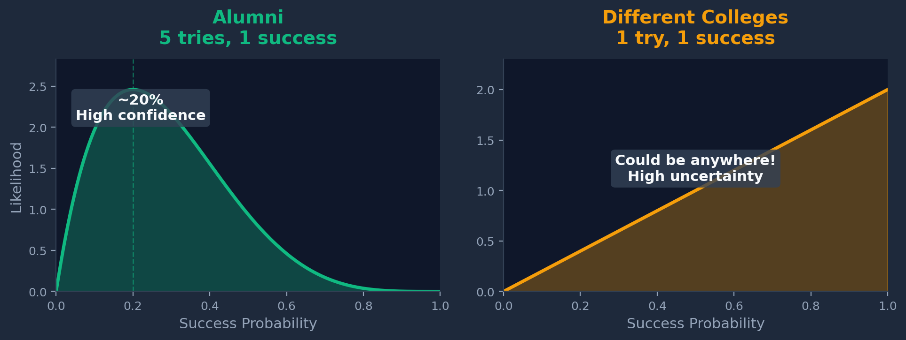
THOMPSON SAMPLING: BAYESIAN APPROACH
Model each option as Beta(successes + 1, failures + 1)
THE ALGORITHM: Sample from each distribution → Pick the highest sample
Notes:
KENNY — 15:00-16:00 • 'We model each option as a probability distribution using the Beta distribution' • Don't get bogged down in math — focus on the intuition: - More data → narrower distribution → more confident - Less data → wider distribution → more uncertain • Alumni example: tried 5 times, narrow curve, you KNOW it's around 20% • Different example: tried once, wide curve — could be anywhere from 10% to 90%! • The algorithm: take a random sample from each distribution, pick the highest • Why this works: uncertain options sometimes sample HIGH, so you naturally explore them • Confident good options stay high, so you naturally exploit them • 'The math automatically balances explore vs exploit for you'

Slide 13
THOMPSON SAMPLING: THE CODE
O(k)
for each connection_type:
α = successes + 1
β = failures + 1
θ ~ Beta(α, β) # Sample
choice = argmax(θ) # Pick highest
per decision
O(log T)
regret — provably optimal!
USED AT
Netflix, Google, FDA
Round 3: Apply Thompson Sampling — START!
Notes:
KENNY — 16:00-16:30 • Walk through the pseudocode quickly — it's actually simpler than epsilon-greedy • Alpha = successes + 1, Beta = failures + 1, sample from Beta distribution • Pick whichever sampled highest — that's it • Key stats to emphasize: - O(k) per decision — same speed as epsilon-greedy - O(log T) regret — PROVABLY near-optimal, way better than epsilon-greedy • Name-drop where it's used: Netflix recommendations, Google experiments, actual FDA clinical trials • 'For Round 3 — think about what you're UNCERTAIN about, not just what worked' • 'If you barely tried something and it worked, try it again — you might have found gold' • Hand off to Zak for final round

Slide 14
ROUND 3 — PLAY NOW
Apply Thompson Sampling!
Be optimistic about uncertainty • Explore what you're unsure about
Notes:
ZAK — 16:30-19:30 (3 min gameplay) • Switch to live game dashboard for the final round • Commentary ideas: - 'People are making more deliberate choices now' - 'Notice how the distribution is shifting compared to Rounds 1 and 2' - Call out if anyone is crushing it — build some friendly competition • After all 4 attempts: announce Round 3 average • Give the full progression: 'Round 1: X, Round 2: Y, Round 3: Z — the strategies worked!' • If scores improved: 'See? Better algorithms = better outcomes' • If scores didn't improve much: 'Remember, 4 attempts per round is very few — with more data Thompson really shines' • Tease the reveal: 'But could you have done even better? Let's find out what was actually going on behind the scenes...' • Switch back to slides

Slide 15
THE REVEAL: HIDDEN SUCCESS RATES
Maya
Jordan
Riley
Data Science
CS Student
Business Analytics
Science/Med 65%
Alumni 70%
Liberal Arts 65%
Biz 60% | Major 30% | Alumni 25%
Upper 55% | Industry 40% | Peers 35%
CS/Eng 60% | Biz 40% | Clubs 30%
Sam
Alex
Taylor
Mech Engineering
CS + Design
Business + Community
Alumni 65%
Adjacent 60%
Alumni 70%
Adjacent 45% | Major 35% | Diff 30%
Diff 50% | Alumni 40% | Major 30%
Diff 65% | Adjacent 55% | Major 35%
Notes:
WILSON — 19:30-21:00 • This is the big reveal moment — build it up • Walk through 2-3 personas in detail: - Maya (Data Science): 'Most of you Mayas probably stuck with your major at 30%, but Science/Med students were at 65%!' - Jordan (CS): 'Alumni connections were 70% — twice as good as CS peers at 35%' - Riley (Business): 'Liberal Arts students at 65% — diverse thinking wins for case comp teams' • Key surprise: the 'obvious' choice (your own major) was almost NEVER the best • Ask: 'How many of you found the optimal connection type?' — celebrate anyone who did • 'The people who explored early had a huge advantage' • Point out: weak ties and cross-disciplinary connections consistently outperformed

Slide 16
THE KEY INSIGHT
There's no universal "best" strategy — it depends on YOUR context.
CAREER GOALS
Alumni & weak ties work best
PROJECTS
Complementary skills beat similarity
RESEARCH
Vertical connections — grad students, faculty
COMMUNITY
Bridging connections across groups
MAB helps you efficiently learn YOUR optimal strategy — that's why LinkedIn's algorithm is personalized.
Notes:
WILSON — 21:00-22:00 • 'There was no single best strategy — it depended entirely on your context' • Walk through each context row: - Career goals: alumni and weak ties consistently beat peers - Projects: you need complementary skills, not copies of yourself - Research: vertical connections (grad students, professors) are gold - Community work: bridging connections across different groups • The meta-lesson: MAB doesn't find THE answer — it efficiently finds YOUR answer • Connect to tech: 'This is exactly why LinkedIn's algorithm is personalized — it's running a bandit on your specific context' • 'Netflix doesn't show everyone the same thumbnails — it's learning what works for YOU'

Slide 17
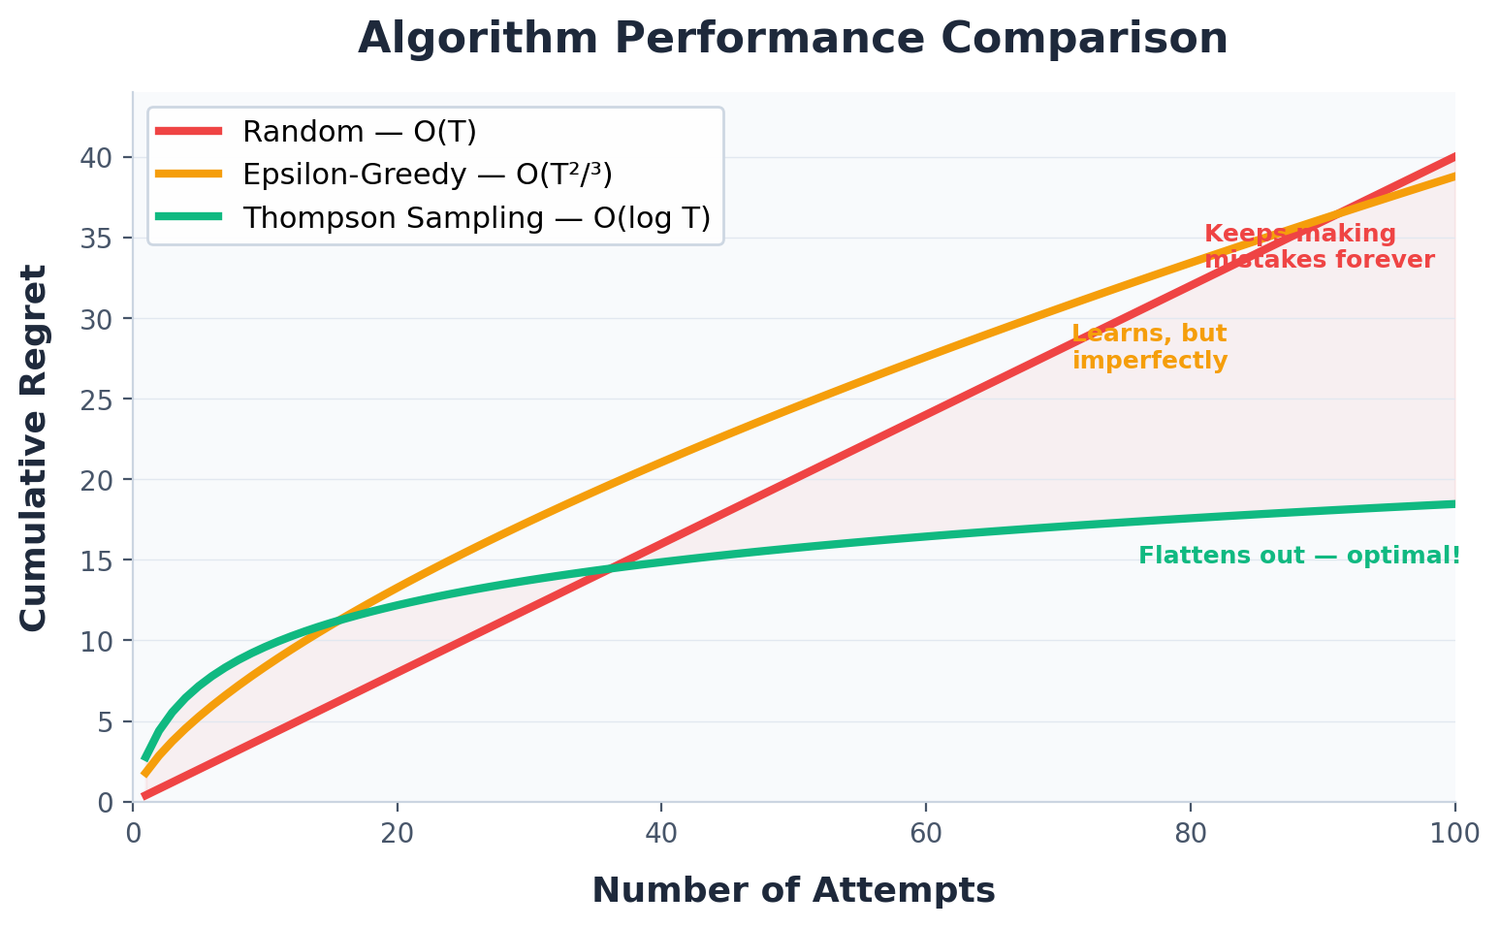
REGRET ANALYSIS
Regret = gap between optimal outcome and what you actually got
Random
O(T)
Linear — keeps making mistakes
Epsilon-Greedy
O(T^{2/3})
Sublinear — good
Thompson
O(log T)
Logarithmic — optimal!
Notes:
WILSON — 22:00-22:30 • Define regret simply: 'The gap between the best you COULD have done and what you actually got' • Walk through the three curves: - Random: linear — you keep making mistakes at the same rate forever - Epsilon-Greedy: sublinear — gets better over time but never fully optimal - Thompson: logarithmic — flattens out fast, barely any regret after a while • 'Thompson is provably near-optimal — you literally can't do much better than O(log T)' • If you have class data: 'Your class average regret was about X per round — optimal would have been around Y' • This is why Thompson is the industry standard for production systems • Key takeaway: smarter exploration = less regret = better outcomes faster

Slide 18

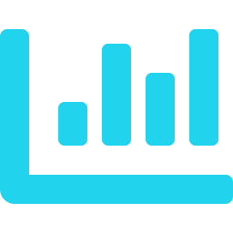



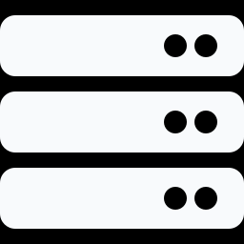
REAL-WORLD APPLICATIONS
Clinical Trials
A/B Testing
FDA-approved adaptive treatment allocation
Google, Facebook, Amazon feature testing
Online Advertising
Resource Allocation
Meta ads platform — which ad creative to show
Portfolio optimization & budget decisions
Recommendations
Network Routing
Netflix, TikTok, YouTube — what to show next
AWS load balancing — which server path
Notes:
LANCE — 22:30-23:30 • This slide shows MAB is everywhere — not just a classroom exercise • Hit each application briefly: - Clinical trials: FDA now approves adaptive trials that allocate more patients to the winning treatment in real time - A/B testing: Google tests thousands of variations simultaneously using bandits - Ads: Meta's ad platform decides which creative to show you — that's a bandit - Resource allocation: where to invest limited budget across competing projects - Recommendations: Netflix, TikTok, YouTube — the 'For You' page is a bandit - Network routing: AWS load balancers decide which server path is fastest • Key point: ANY repeated decision under uncertainty with limited resources = MAB • 'You'll encounter this framework everywhere in industry, not just in this class'

Slide 19
WHY THIS MATTERS
Real-world optimization has:
MAB FRAMEWORK
Unknown parameters — you don't know rates upfront
A principled way to balance learning vs. earning
Limited resources — can't try everything infinitely
Changing conditions — preferences drift over time
THOMPSON SAMPLING
O(log T) regret
Provably near-optimal
Works in practice
Cost of exploration — every failed attempt has a cost
Notes:
LANCE — 23:30-24:00 • Zoom out to the bigger picture — why does this matter beyond today? • Most real-world optimization has these 4 properties: - Unknown parameters: you don't know success rates upfront - Limited resources: can't try everything forever - Changing conditions: what works today might not work tomorrow - Cost of exploration: every failed attempt costs something (time, money, a patient's health) • MAB gives you a PRINCIPLED framework for balancing learning vs earning • Thompson Sampling specifically: O(log T) regret, provably near-optimal, works in practice • Connect to your own project: 'We're building a networking platform and this is exactly the problem we're solving' • 'Any exploration-exploitation tradeoff you face in your career — choosing jobs, investing, trying new tools — you can think about it through this lens'

Slide 20

QUESTIONS?
When is exploration unethical?
What if probabilities change over time?
Where else do you see explore-exploit tradeoffs?
Lance | Wilson | Zakaria | Tatum | Kenny
Notes:
ALL — 24:00-25:00+ (Q&A buffer) • Open the floor — 'Any questions about the algorithms, the game, or how this applies?' • If no questions, use the discussion prompts on screen: - Ethics: 'When is exploration unethical? Think clinical trials — at what point do you STOP giving patients the worse treatment?' - Non-stationary: 'What if probabilities change over time? User preferences drift — Netflix has to keep re-learning' - Other tradeoffs: 'Where else do you see explore-exploit? Restaurants, career moves, relationships, investments...' • Be ready to discuss extensions if asked: - Contextual bandits: using extra info (demographics, time of day) to personalize further - Non-stationary bandits: adding a decay/forgetting factor - Multi-objective bandits: optimizing for multiple things at once • Wrap up: thank the audience, remind them of the key takeaway — smart exploration beats blind guessing every time

